Slide 1

Spring Framework
Dima Ionut Daniel

Slide 2
Contents
What is Spring?
History
Spring Modules
Spring Core
Spring Configuration
Autowiring
SpEL
Aspect-oriented Spring
Spring Advanced
Conclusions
Bibliography

Slide 3

What is Spring?
Spring is an open source application framework .
Spring is an inversion of control container(IoC) for the Java platform.
Spring can be used for building web applications on top of the Java EE platform.

Slide 4
History
The first version was written by Rod Johnson who released the framework in October 2002
The framework was first released under the Apache 2.0 license in June 2003.
The first milestone release, 1.0, was released in March 2004.
Spring 2.0 was released in October 2006, Spring 2.5 in November 2007, Spring 3.0 in December 2009, Spring 3.1 in December 2011, and Spring 3.2.5 in November 2013.
The current version is Spring Framework 4.0, which was released in December 2013.

Slide 5
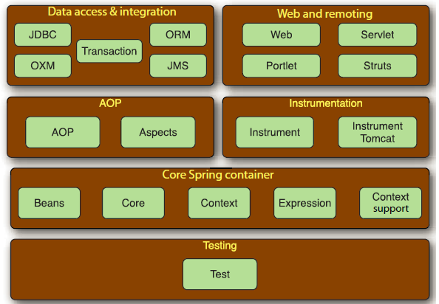
Spring Modules
Spring Framework is focused on simplifying enterprise Java development through dependency injection.
The Spring Framework is composed of several distinct modules.
Spring Framework is focused on simplifying enterprise Java development through dependency injection, aspect-oriented programming, and boilerplate reduction.

Slide 6
Spring Modules (cont.)
Spring Core
Container that manages how the beans are created, configured and managed.
Spring AOP
Provides AOP support with loose coupling of application objects.
Data access and integration
Provides easy access to DB
Web and Remoting
MVC(Model-View-Controller) paradigm is used.
Spring includes RMI, Hessian, Burlap, JAX-WS, HTTP Invoker.
Testing
Support for testing

Slide 7
Spring Modules (cont.)
Spring Web Flow
Support for building conversational, flow-based applications
Spring Web Services
Spring can publish Web Service applications
Spring Security
Offers a declarative security mechanism for applications
Spring Integration
Support for integrating with other external systems(ESB,EAI)
Spring Batch
Support for batch applications

Slide 8
Spring Modules (cont.)
Spring Social
Support for integrating with twitter and facebook
Spring Mobile
Spring support for mobile applications for devices like tables, smartphones.
Spring Dynamic Module
Spring DM can be used in OSGI applications, OSGI Blueprint containers.
Spring LDAP
Support for interacting with Directory Services using LDAP protocol.
Spring Rich Client
Support for Java Swing applications
Spring Roo
Applications can be build very fast with frameworks as Rails, Grails.

Slide 9
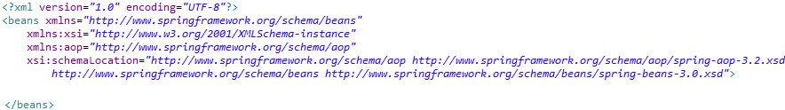
Spring Core
Spring is a container-based framework.
Spring 3.0 also offers a Java-based configuration option.
Before that the Spring configuration was defined as XML file.
Within the <beans> the Spring configuration resides.

Slide 10
Spring Core (cont.)
Spring comes with several XML namespaces which can configure Spring containerŞ
aop → declares aspects
beans → core primitive Spring namespace, declaring beans and how they can be wired
context → elements for configuring Spring application context, autodetect, autowire, injection,etc
jee → integration with Java EE API such as JNDI and EJB.
jms → configuration elements for declaring message-driven POJOs.
lang → declaration of beans that are implemented as Groovy, JRuby, BeanShell scripts.
mvc → enable Spring MVC capabilities such as controllers, views,interceptors.
oxm → support for Spring object-to-XML mapping
tx → declarative transaction configuration
util → selection of utility elements.

Slide 11
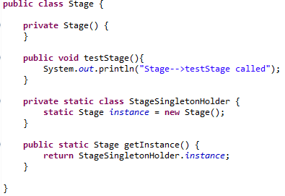
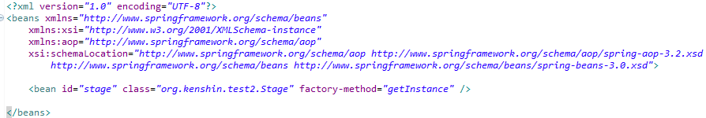
Spring Core (cont.)
Depedencies can be injected via constructor or setter.
In case we want to contruct beans that have static getInstance() methods factory-method attribute(from <bean> tag) can be used.
If the class is created from another bean the factory-bean attribute can be used to specify the class.

Slide 12
Spring Core (cont.)
By default all Spring beans are singletons.
The scope can be overriden. Posible scope values:
Singleton → single instance per Spring container (default)
Prototype → allows a bean to be instantiated any number of times
Request → scopes a bean definition to an HTTP request.
Session → scopes a bean definition to an HTTP session.
Global-session → scopes a bean definition to a global HTTP session(valid when used in a portlet context).
Spring singleton beans only guarantee a single instance of the bean definition per the application context.

Slide 13
Spring Core (cont.)
Spring Beans have init-method and destroy-method parameters for defining setup and teardown for a bean.
An optional way to define init and destroy methods for a bean is toimplement Spring’s InitializingBean and DisposableBean interfaces.
InitializingBean declares an afterPropertiesSet() method that serves as the init method.
DisposableBean declares a destroy() method that gets called when a bean is removed from the application context.

Slide 14
Spring Core (cont.)
The namespace p can be used to wiring values are references in a easy manner.
Spring can configure values, references.
The <list> and <set> elements are useful when configuring properites that are either arrays or some implementation of java.util.Collection.
The <map> and <props> elements can be used to declare collections of name-value pairs.
The <null/> element can be used to declare the null value.

Slide 15
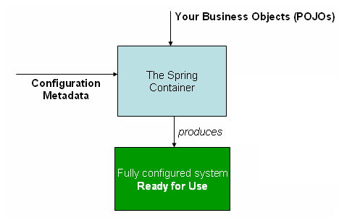
Spring Configuration
The org.springframework.beans and org.springframework.context packages are the basis for Spring Framework’s IoC container.
The BeanFactory interface provides an advanced configuration mechanism capable of managing any type of object.
ApplicationContext is a sub-interface of BeanFactory.
Sevaral most used ApplicationContext implementations: ClassPathXmlApplicationContext or FileSystemXmlApplicationContext.

Slide 16
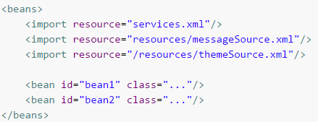
Spring Configuration (cont.)
Forms of metadata with the Spring container:
Annotation-based: Spring 2.5 introduced support for annotation-based configuration metadata.
Java-based: Starting with Spring 3.0, many features provided by the Spring JavaConfig project became part of the core Spring Framework.
We can define beans external to your application classes by using Java rather than XML files.
To use these new features, see the @Configuration, @Bean, @Import and @DependsOn annotations.
We can have the beans definition span over multiple XML files.

Slide 17
Spring Configuration (cont.)
A Spring IoC container manages one or more beans.
The beans are created with the configuration metadata in the form of XML <bean/> definitions.
Within the container itself, these bean definitions are represented as BeanDefinition.
This metadata translates to a set of properties for the bean definition: class, name, scope, constructor arguments, properties, autowiring mode, lazy-initialization mode, initialization method, destruction method.
We can retrieve the BeanFactory from ApplicationContext using the getBeanFactory() in order to get extra information about bean definitions.
The default BeanFactory implementation is DefaultListableBeanFactory.
It supports this registration through the methods registerSingleton(..) and registerBeanDefinition(..)

Slide 18
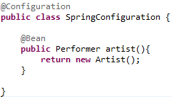
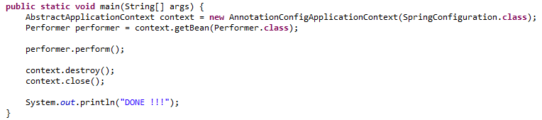
Spring Configuration (cont.)
The Java-based equivalent to that XML is a Java class annotated with @Configuration.
The @Configuration annotation tells Spring that this class will contain one or more Spring bean declarations.
@Bean is used to wire beans using Spring’s Java based configuration.

Slide 19
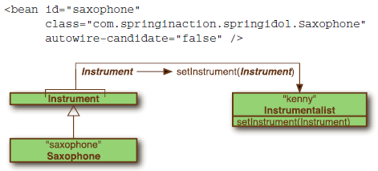
Autowiring
Spring offers autowiring, in case we don’w want to explicity declare the wiring in the metadata.
Spring has 4 flavors of autowiring:
byName: attempts to match all properties using the bean IDS.
byType: attempts to match all properties using the types.
constructor: tries to match up a constructor based also on the arguments.
autodetect: tries to apply constructor autowiring first; if that fails byType will be tried.
The autowire-candidate attribute can be use to include or exclude the bean from beeing used as dependency.

Slide 20


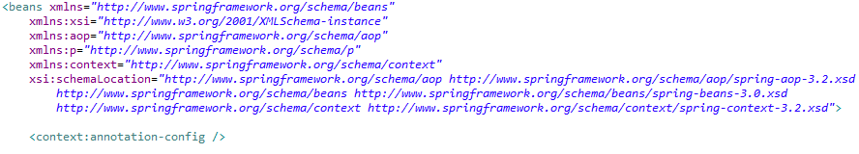
Autowiring (cont.)
With Spring 2.5 Spring can to autowire automatically by using annotations.
Annotation wiring isn’t turned on in the Spring container by default.
<context:annotation-config> tells Spring that you intend to use annotation-based wiring in Spring.
Spring 3 supports a few different annotations for autowiring:
Spring’s own @Autowired annotation
The @Inject annotation from JSR-330
The @Resource annotation from JSR-250
@Autowired can be used on constructor, field or setter method(isn’t mandatory).

Slide 21

Autowiring (cont.)
By default, @Autowired has a strong contract, requiring that the thing it annotates is wired.
If no bean can be wired into the @Autowired-annotated property or argument, then autowiring fails(NoSuchBeanDefinitionException).
We can indicate certain dependencies to be optional by setting @Autowired’s required attribute to false.
When used with constructors, only one constructor can be annotated with @Autowired and required set to true.
@Qualifier can be used to indicate the beans by using the name.
We might use @Inject annottion instead of Spring @Autowired.

Slide 22
Autowiring (cont.)
To configure Spring for autodiscovery, we can use <context:component-scan> instead of <context:annotation-config>.
By default, <context:component-scan> looks for classes that are annotated with one of the special stereotype:
@Component – general-purpose annotation.
@Controller – class that defines a Spring MVC controller.
@Repository – class tht defines a data repository .
@Service – indicates that the class defines a service.
Any custom annottion that is itself annotated with @Component.
We can use <context:include-filter> and/or <context:exclude-filter> subelements to tweak component scanning.

Slide 23


SpEL
The Spring Expression Language(SpEL) is a powerful expression language that supports querying and manipulating an object graph at runtime.
The language syntax is similar to Unified EL but offers additional features
The simplest possible SpEL expression is one that contains only a literal value.
The ?. Operator can be used to avoid NullPointerException in SpEL.

Slide 24
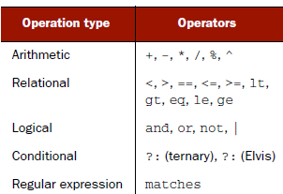
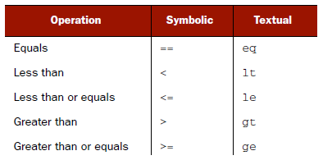

SpEL (cont.)
The T() operator can be used to work with types.
SpEL supports all of the basic arithmetic operations that Java supports.

Slide 25
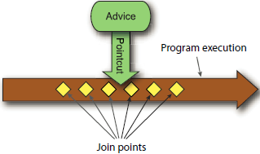
Aspect-oriented Spring
Aspects are often described in terms of advice, pointcuts, and join points.
In AOP terms, the job of an aspect is called advice.
Advice defines both the what and the when of an aspect.
Spring aspects can work with 5 kinds of advice:
Before: the advice functionality takes place before the advised method is invoked.
After: the advice functionality takes place after the advised method completes, regardless of the outcome.
After-returning: the advice functionality takes place after the advised method successfully completes.
After-throwing: the advice functionality takes place after the advised method throws an exception.
Around: The advice wraps the advised method, providing some functionality before and after the advised method is invoked.

Slide 26
Aspect-oriented Spring (cont.)
A join point is a point in the execution of the application where an aspect can be plugged in.
This point could be a method being called, an exception being thrown, or even a field being modified.
Pointcuts help narrow down the join points advised by an aspect.
If advice defines the what and when of aspects, then pointcuts define the where.
An aspect is the merger of advice and pointcuts.
Advice and pointcuts define everything there is to know about an aspect:
what it does and where and when it does it.

Slide 27
Aspect-oriented Spring (cont.)
An introduction allows you to add new methods or attributes to existing classes.
The new method and instance variable can then be introduced to existing classes without having to change them.
Weaving is the process of applying aspects to a target object to create a new proxied object.
The aspects are woven into the target object at the specified join points.
1)Compile time:
Aspects are woven in when the target class is compiled.
It requires a special compiler
2)Classload time:
Aspects are woven in when the target class is loaded into the JVM
It requires a special ClassLoader that enhances that target class’s bytecode before the class is introduced into the application.
3)Runtime:
Aspects are woven in sometime during the execution of the application.
An AOP container will dynamically generate a proxy object that will delegate to the target object while weaving in the aspects.

Slide 28
Aspect-oriented Spring (cont.)
Aspect frameworks:
AspectJ
JBoss AOP
Spring AOP
Spring’s support for AOP comes in 4 flavors:
Classic Spring proxy-based AOP
@AspectJ annotation-driven aspects
Pure-POJO aspects
Injected AspectJ aspects (available in all versions of Spring)

Slide 29
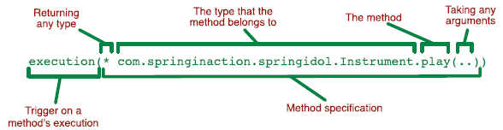
Aspect-oriented Spring (cont.)
AspectJ pointcut supported in Spring AOP:
args() --> matches to the execution of methods whose arguments are instances of the given types
@args() --> matches to the execution of methods whose arguments are annotated with the given annotation types
execution() --> Matches join points that are method executions
this() --> matches to those where the bean reference of the AOP proxy is of a given type
target() --> matches to those where the target object is of a given type
@target() --> the class of the executing object has an annotation of the given type
within() --> its matching to join points within certain types
@within() --> Limits matching to join points within types that have the given annotation
@annotation --> matches to those where the subject of the join point has the given annotation

Slide 30
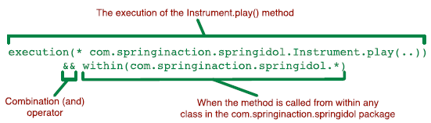

Aspect-oriented Spring (cont.)
We can use the && operator to combine execution() with within() designators.
Spring 2.5 introduces a new bean() designer that can identify beans by their ID within a pointcut expression.

Slide 31
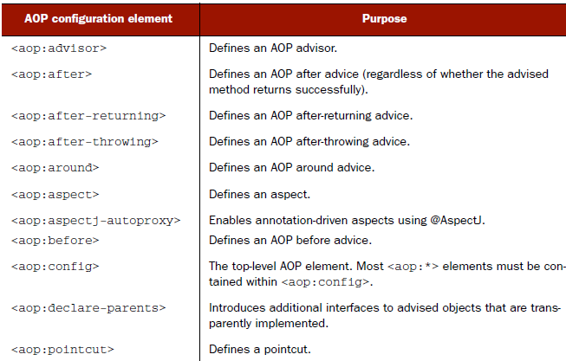
Aspect-oriented Spring (cont.)
Spring AOP configuration elements:

Slide 32

Spring Advanced
ApplicationContextAware can be used to inject ApplicationContext into beans.
BeanNameAware can be used to store the bean name.
Other aware interfaces: BeanFactoryAware, LoadTimeWeaverAware, ServletConfigAware, ServletContextAware, PortletConfigAware, PortletContextAware, etc

Slide 33
Conclusions
Spring is very flexible
Spring is open source
Spring is a powerfull Inversion of Control framework
Spring comes with multiple modules

Slide 34

Bibliography
http://en.wikipedia.org/wiki/Spring_Framework
http://docs.spring.io/spring/docs/current/spring-framework-reference
Manning – Spring in Action 3rd Edition

